Slide 1
Credit Card Default Prediction
Project Type - Classification
By Ankita Gupta

Slide 2
Content
Problem Defination
Dataset
Modelling
Result and Visualization

Slide 3
Exploratory Data Analysis(EDA)
Firstly checked distribution of target variables and independent variables.
Checked number of values in categorical features.
Replaced the values that are lowest in categorical features.
Replaced the other values with a particular value in some numerical features such as pay status.
Dummyfied the categorical features.
Checked correlation to see if there are any highly correlated independent features.

Slide 4
Business understanding
Credit card is a type of unsecured loan. An unsecured loan is loan without any collateral such as house or a fixed deposit.
Defaulted credit card refers to a solution where a credit card holder fails to make the required minimum payments on their credit card account for a certain period of time, typically several consecutive month.
So in this project our aim will be to build a model which will help top predict whether a customer will default the payment of his/her credit card so that the banks can understand the characteristics that lead to this outcome.

Slide 5
Our Goal
We focus on finding the relationship between various cardholder and their ability to repay.
We will use Machine learning to learn all available features of all cardholders in the dataset and predict whether or not they will default in the next month.
In this project we will try to investigate the result of predicting default using different models with different training method and data preprocessing technique.

Slide 6
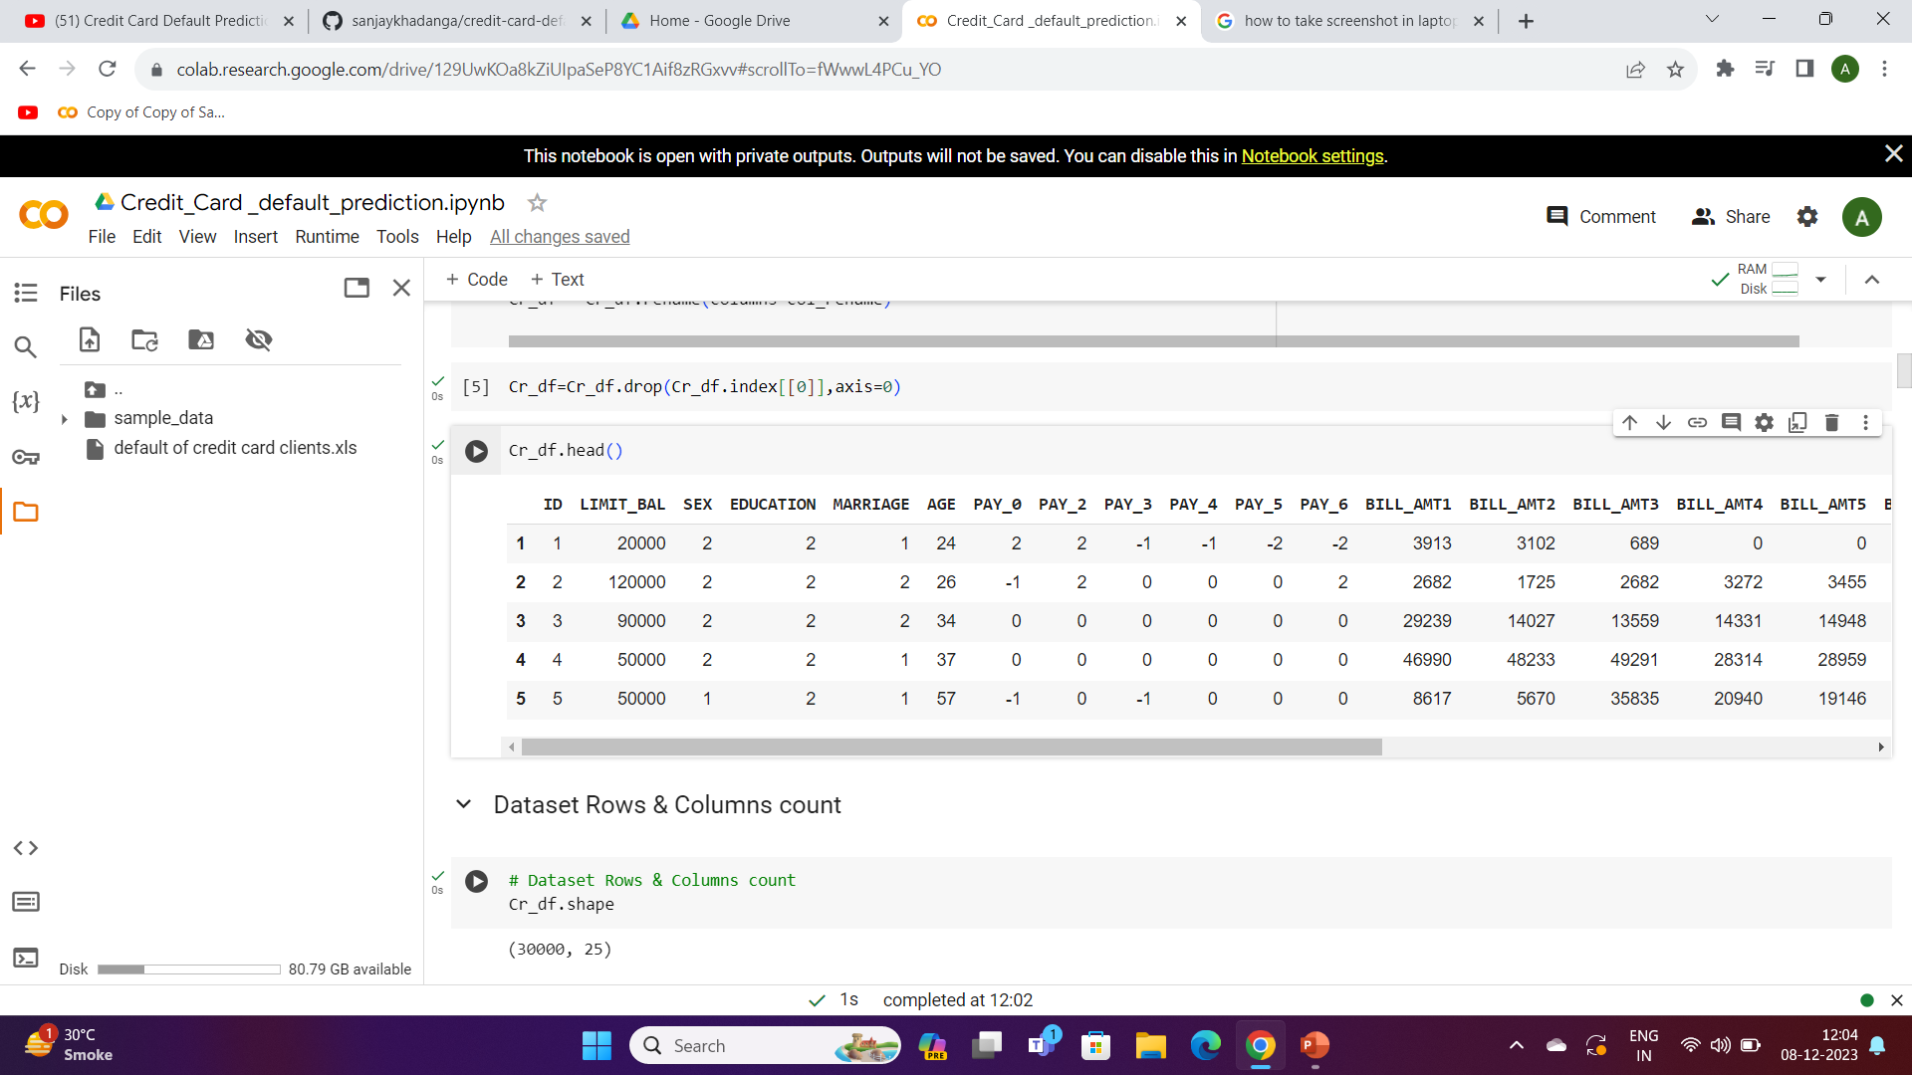
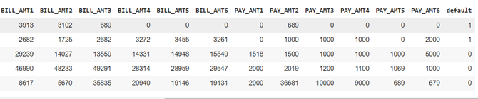
Data summary

Slide 7
Feature analysis
X1: Amount of Credits
X2: Gender
X3: Education
X4: Marital Status
X5: Age
X6 – X11: History of past payments from April to September
X12 – X17: Amount of bill statement from April to September
X18 – X23: Amount of previous payments from April to September
Y: Default Payment

Slide 8
Insights from dataset
This dataset is from Tiwan.
There are no missing/duplicate/null values in the dataset.
The given dataset contains 30000 rows and 25 columns. There are 24 independent variables and 1 target variable in our dataset.
The initial problem was reading the information as it was indicated column name as X and Y, so we have renamed it. 'Default' is our target variable that we have to predict.
The column name we have renamed it: 'ID', 'LIMIT_BAL', 'SEX', 'EDUCATION', 'MARRIAGE', 'AGE', 'PAY_0', 'PAY_2', 'PAY_3', 'PAY_4', 'PAY_5', 'PAY_6', 'BILL_AMT1', 'BILL_AMT2', 'BILL_AMT3', 'BILL_AMT4', 'BILL_AMT5', 'BILL_AMT6', 'PAY_AMT1', 'PAY_AMT2', 'PAY_AMT3', 'PAY_AMT4', 'PAY_AMT5', 'PAY_AMT6', 'default

Slide 9
The name of the individual variables and descriptions of them mentioned below:
ID: ID of each client
LIMIT_BAL: Amount of given credit by customers
SEX: Gender(1=male, 2=female)
EDUCATION: Qualification of the customers(1=graduate school, 2=university,3= high school, 4=others, 5=unknown, 6=unknown)
MARRIAGE: Marital status (1=married,2=single,3=others)
AGE: Age in years
PAY_0:Repayment status in September,2005(-1=pay duly, 1=payment delay for one month,2=payment delay for two month,..8=
payment delay for eight months, 9=payment delay for nine months and above)
PAY_2:Repayment status in August, 2005(scale same as above)
PAY_3:Repayment status in July, 2005(scale same as above)
PAY_4:Repayment status in June, 2005(scale same as above)

Slide 10
PAY_5:Repayment status in May, 2005(scale same as above)
PAY_6:Repayment status in April, 2005(scale same as above)
Bill_AMT1:Amount of bill statement in September,2005(NT dollar)
Bill_AMT2:Amount of bill statement in August,2005(NT dollar)
Bill_AMT3:Amount of bill statement in July,2005(NT dollar)
Bill_AMT4:Amount of bill statement in June,2005(NT dollar)
Bill_AMT5:Amount of bill statement in May,2005(NT dollar)
Bill_AMT6:Amount of bill statement in April,2005(NT dollar)
PAY_AMT1:Amount of previous payment in September,2005(NT dollar)
PAY_AMT2:Amount of previous payment in August,2005(NT dollar)
PAY_AMT3:Amount of previous payment in July,2005(NT dollar)
PAY_AMT4:Amount of previous payment in June,2005(NT dollar)
PAY_AMT5:Amount of previous payment in May,2005(NT dollar)
PAY_AMT6:Amount of previous payment in April,2005(NT dollar)
default.payment.next.month:Default payment(1=yes,0=no)

Slide 11
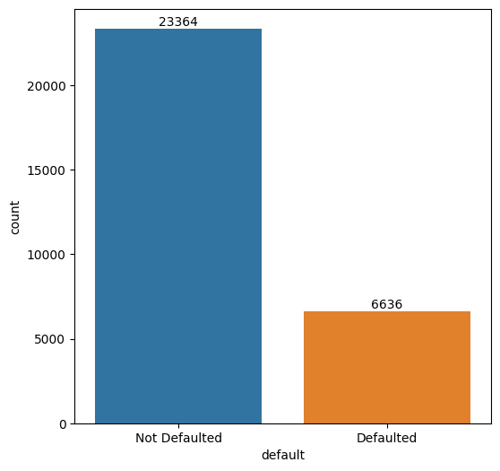
Analysis of Dependent Variable
As we can see This data is quite imbalance which about 22% of clients will next month.
Not defaulted : 23364
Defaulted: 6636

Slide 12
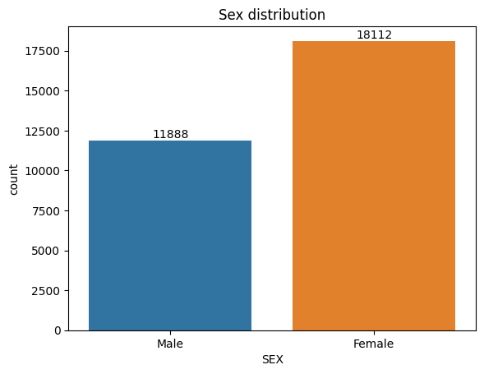
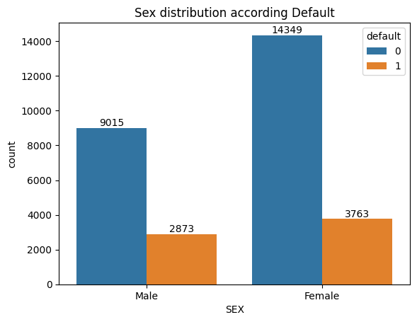
More Female clients own credit card than Male client. Number of defaulter have high proportion of males.

Slide 13
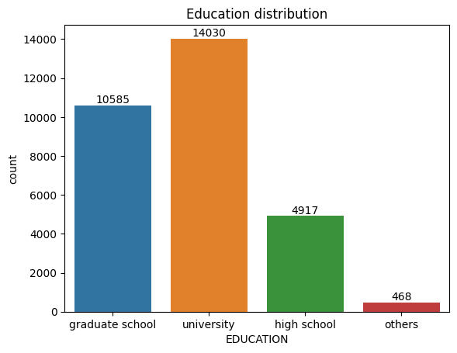
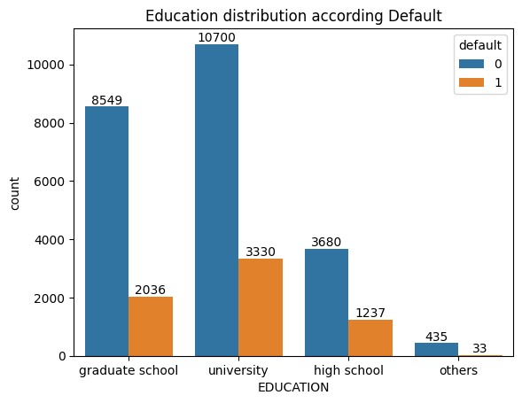
Analysis of Education Variable
1=Graduate school; 2=university; 3=high school; 4=others
From the above left side plot we can say that more number credit holders are university students followed by Graduates and high school students.
From the right plot we can say High school students are the group which has highest fraud cases(25%), follow by university students(23%).

Slide 14
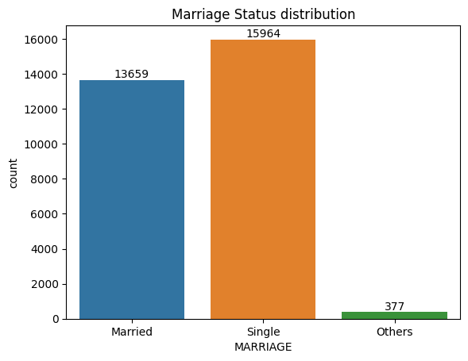
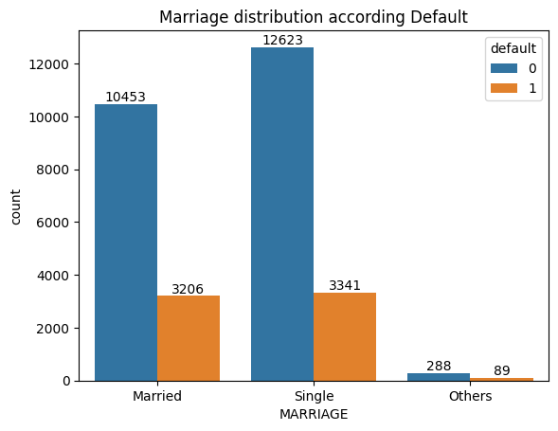
1 = married; 2 = single; 3 = others
Single is the group which highest number of customers using credit cards.
Married people are the group which has highest fraud cases.

Slide 15
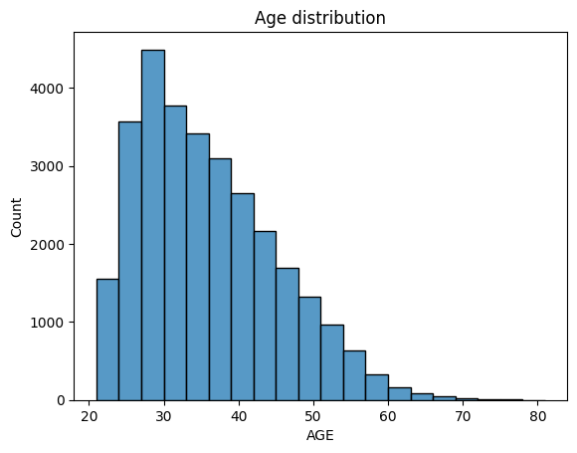
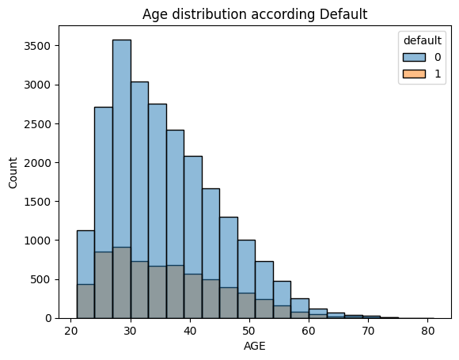
Age Variable
More numbers of credit card holder is between 26 – 30.
Customers in their 30s are also the most prone to credit fraud.

Slide 16
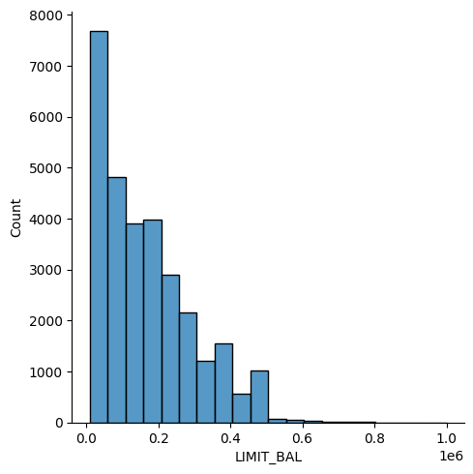
Analysis of Limit Balance Variable
The distplot function in the seaborn library is used to visualize the distribution of univariate (single-variable) sets of observations.
The average limit balance is around 4000-5000.

Slide 17
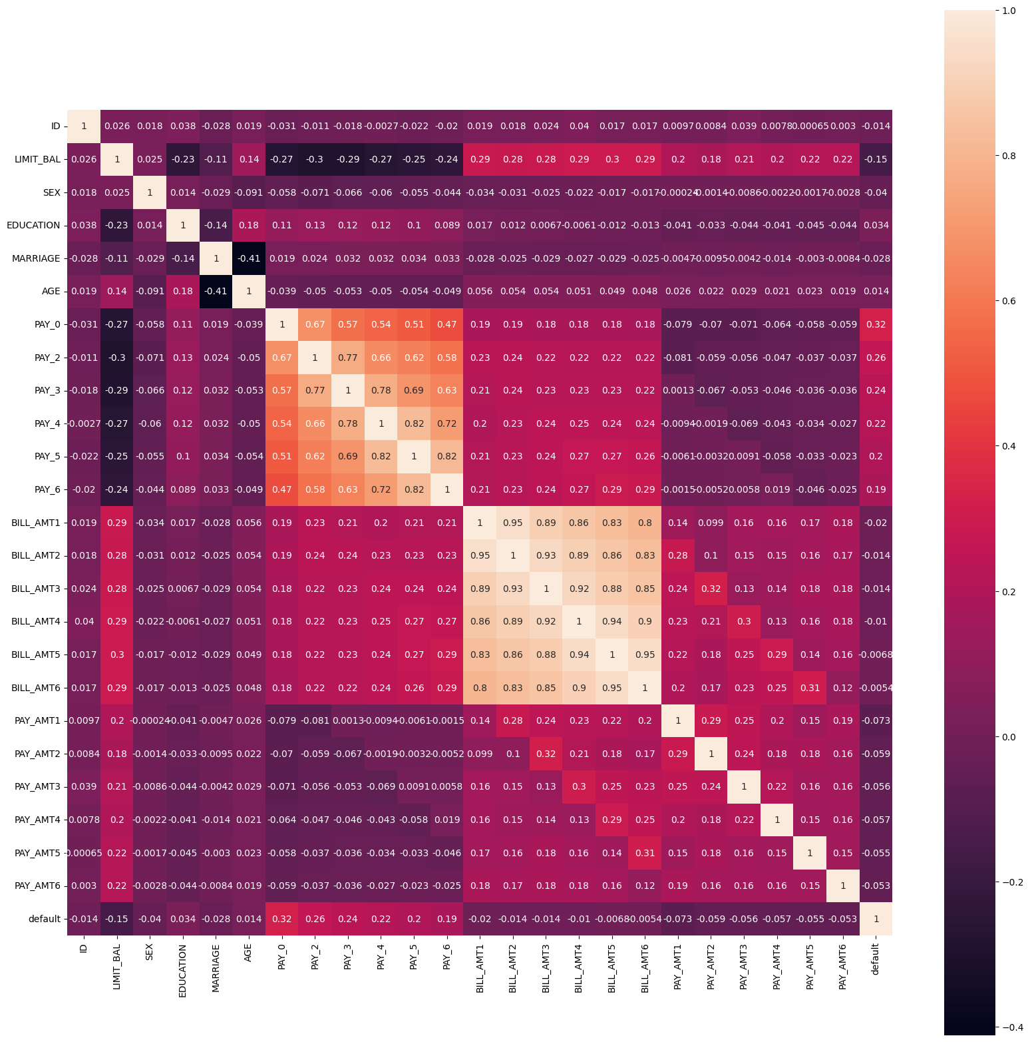

Slide 18
Building Model:
Logistic Regression
Random Forest Classifier
Decision Tree
XGBoost Classifier

Slide 19
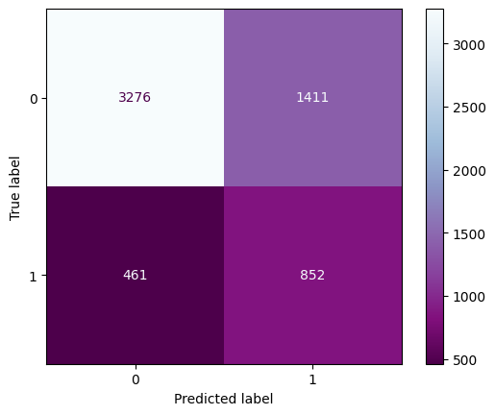
Logistic Regression
From this regression model we get the results as below:
The accuracy on test data is: 0.688
The precision on test data is: 0.77
The recall on test data is: 0.69
The F1 on test data is: 0.71

Slide 20
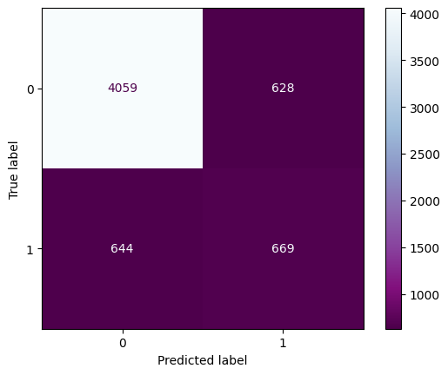
Decision Tree Classifier:
From this regression model we get the results as below:
The accuracy on test data is: 0.788
The precision on test data is: 0.79
The recall on test data is: 0.79
The F1 on test data is: 0.79

Slide 21
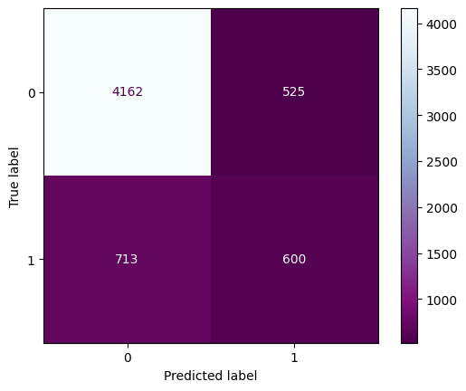
Random Forest:
From this regression model we get the results as below:
The accuracy on test data is: 0.793
The precision on test data is: 0.78
The recall on test data is: 0.79
The F1 on test data is: 0.79

Slide 22
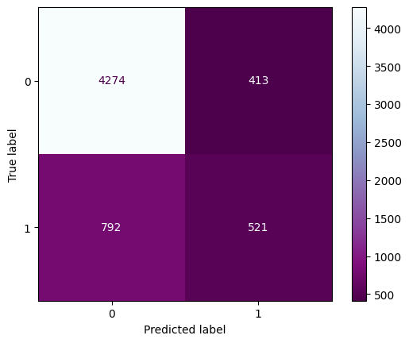
XGboost:
From this regression model we get the results as below:
The accuracy on test data is: 0.7991
The precision on test data is: 0.78
The recall on test data is: 0.80
The F1 on test data is: 0.79

Slide 23
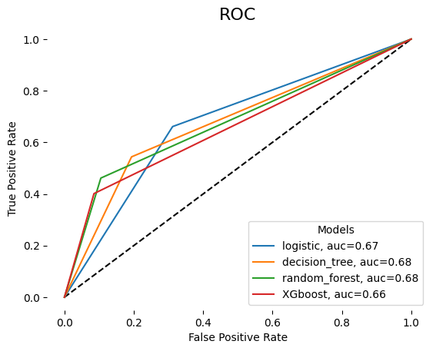
AUC-ROC curve comparison
An ROC curve is a graph showing the performance of a classification model at all classification thresholds.
The decision tree shows highest True positive rate.

Slide 24
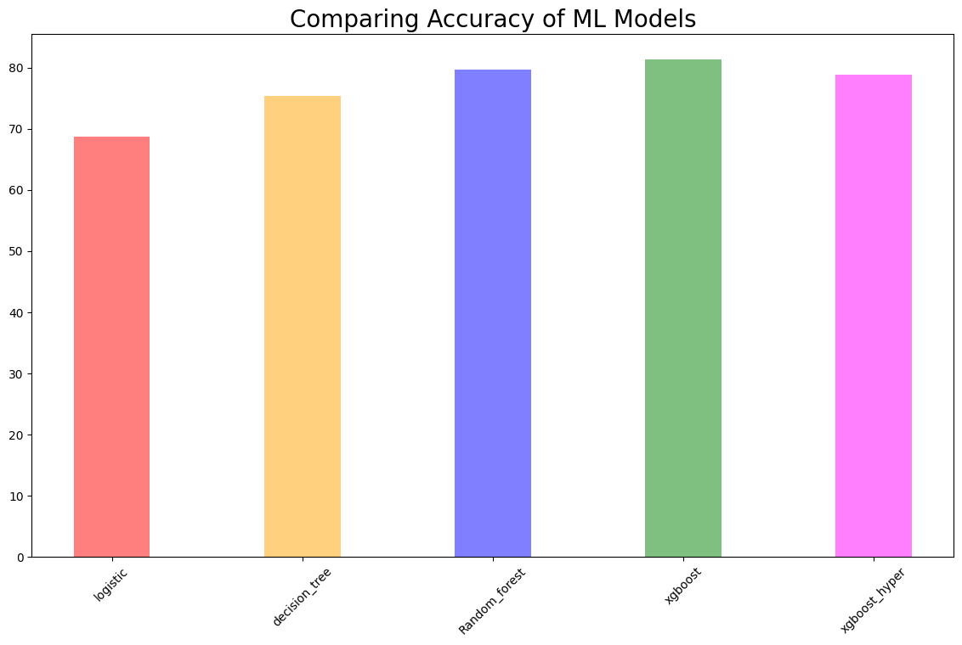

Slide 25
Challenges
Large dataset to handle
Feature analysis
Need to remove outliers
Feature Engineering
Getting the higher accuracy on the models
Carefully handled the feature imbalanced data
Carefully tuned hyperparameter

Slide 26
Conclusion
In this project, we first check for data unbalancing, visualize the feature and investigate in the relationship between different feature to find the strongest predictors of default payment.
We then run different 5 ML models in order to find the best model for detecting credit default:
Logistic model with 68.65% accuracy,
Decision_tree model with 75.36% accuracy,
Random_forest model with 79.73% accuracy,
XGboost model with 81.4% accuracy,
XGboost_hyperparameter model with 78.85% accuracy
Among all the ML model we use to predict the default credit card, XGboost is the best model with highest accuracy score.

